Slide 1
Interpretive Structural Modeling (ISM): Case exercise
By
Dr. K. MATHIYAZHAGAN
Assistant Professor (Selection Grade)
Mechanical Engineering,
ITM University,
Gurgaon, Hayana.
Mail id: madii1984@yahoo.com
k.mathiyazhagan@itmindia.edu
Notes:
SCHEDULING FOR MANUFACTURING SYSTEMS – a meta heuristic approach
By
M.Saravanan,M.E.,
Assistant Professor , Dept.of Mech.Engg,
R.V.S.College of Engg.& Tech,
Dindigul.
Under the Guideance of
Dr.A.NOORUL HAQ , M.E.,Ph.D.,
Professor and Head,
Dept.of Production Engg.
National Institute of Technology,
Trichyrapalli.
Details of Registration
Name of the scholar : M.Saravanan
Reg.Number : 200327910
University : Anna University,Chennai.
Co-ordinating centre : National

Slide 2
The various steps involved in the ISM methodology
Step 1: Variables (criteria) considered for the study.
Step 2: From the variables identified in step 1, a contextual relationship is established among the variables in order to identify as to which pairs of variables should be examined.
Step 3: A Structural Self-Interaction Matrix (SSIM) is developed for variables, which indicates pairwise relationships among the variables of the system under consideration.
Step 4: Reachability matrix is developed from the SSIM and the matrix is checked for transitivity. The transitivity of the contextual relation is a basic assumption made in ISM. It states that if a variable A is related to B and B is related to C, then A is necessarily related to C.

Slide 3
Step 5: The reachability matrix obtained in step 4 is partitioned into different levels.
Step 6: Based on the relationships given above in the reachability matrix, a directed graph is drawn and the transitive links are removed.
Step 7: The resultant digraph is converted into an ISM, by replacing variable nodes with statements.
Step 8: The ISM model developed in step 7 is reviewed to check for conceptual inconsistency and necessary modifications are made.

Slide 4
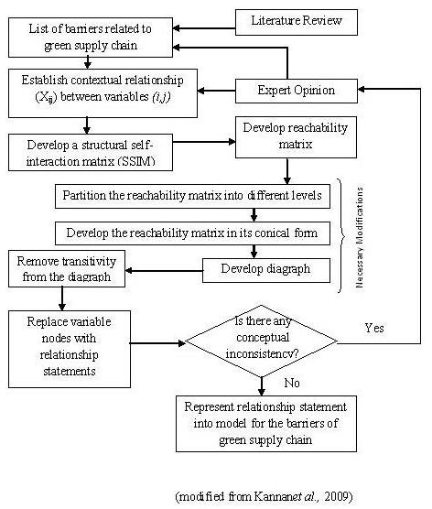

Slide 5
An ISM Approach for the Barrier Analysis in Implementing Green Supply Chain Management
Mathiyazhagan K, Kannan Govindan, Noorul Haq A, Yong Geng (2013) “An ISM approach for the barrier analysis in implementing green supply chain management”, Journal of Cleaner Production (Elsevier), 47, 283-297. (Impact Factor: 3.398)
Problem Description
The inability to adopt Green Supply Chain Management (GSCM) within their firms has been one of the important barriers in Indian SMEs and lack of government regulations also another important barrier to adopt GSCM.
Thus, it is very important to identify the imperative barriers which affect the implementation of GSCM.
In this study this research gap is identified and the mutual relationship of twenty-six barriers for the implementation of GSCM
Ten auto component manufacturing industries in Tamilnadu, South India are considered for this study.

Slide 6
Barriers for GSCM adoption with references
Barriers | Description | Sources
1. Problem in maintaining the environmental awareness suppliers (B1) | Industries are unable to maintain the environmental conscious suppliers and suppliers also are concerned to maintain the environmental concepts in their industries | Gibbon (1997); Sarkar and Mohapatra (2006); Wycherley (1999); Mudgal et al., (2010)
2. Complex to measure and monitor the environmental practice of suppliers (B2) | Metrics misalignment is thought to be a primary source of inefficiency and disruption in supply chain interactions | Morgan (2006); Faisal et al. (2007); Mudgal et al. (2010)
3. Lack of government support to adopt Environmental friendly policies (B3) | Legislation and regulation are the instruments very much necessary for the proper governance of business enterprises including the environment in which they operate. Environmental laws and regulations are an important framework, within which the companies must operate | Porter and van de Linde (1995); Greer and Bruno (1996); Scupola (2003); AlKhidir and Zailani (2009)
4. Fear of failure (B4) | Involves the fear of failure while adopting green supply chain which could lead to monetary losses for the firm or the fear of failure of the product, hence leading to losing the competitive advantage | Rao and Holt (2005); Perron (2005); Shrivastava (1995); Hansson et al., (2003)
5. Lack of effective environmental measures (B5) | Environmental measurement is essential for implementing and maintaining the green concept in industry | Rao and Holt (2005)

Slide 7
Lack of Human resource (B6) | Lack of number of laborers in the organization and/or the quality of the employees. Basically, a fundamental obstacle to improving environmental performance of the SME sector is a lack of human resources. Lack of in-house expertise in environmental matters (human resources) | Perron (2005); Rowe and Enticott (1998); Thompson (2002); Hillary (2004)
Lack of technical expertise (B7) | Inability to find an alternative way to design a pollution free product to fulfill environmental requirements. Lack of financial resources for equipment and other Investments (especially long term).Technical support is not updated within industry | Perron (2005); Hemel and Cramer (2002); Hillary (2000); Ofori et al., (2000); Revell et al., (2003)
Complex in design to reuse or recycle the product (B8) | Inability of technology and knowledge to design the reuse and recycle of used products | Our contributed barrier
Lack of new technology, materials and processes (B9) | Unavailability of appropriate technology or process within an organization to adopt green supply chain. Lack of belief in the benefits of environmental initiatives | (Perron 2005)
Lack of awareness about reverse logistics adoption (B10) | Adoption of reverse logistics practices is critical for organizations from both economic and environmental perspectives | Ravi and Shankar (2005); Marsillac (2008); Meade et al., (2007)

Slide 8
Disbelief about the environmental benefits (B11) | Industries do not believe in environmental benefits for implementing green concept | Klassen and Whybark (1999); Shrivastava (1995); Freeman et al., (1992)
Perception of “out-of-responsibility” zone (B12) | Perception of an organization that taking steps towards environmental good-will is not their responsibility. Lack of appropriate organizational structures and widespread ignorance of supply chain philosophy are also barriers identified for implementation of GSCM | Akintola et al., (2000); Shen and Tam (2002); Hillary (2000)
Lack of Environmental Knowledge (B13) | Among SMEs lack of knowledge about environmental impacts or underrating of the environmental impacts is common, one reason is that legal doorway is commonly bigger | Bowen et al., (2001); Shen and Tam (2002); Hillary (2000); Barchard, (1998); Tilley (1999); Williams et al., (2000)
Lack of green system exposure professionals (B14) | SMEs are well known for lacking human resources both in quantity and in technical knowledge to pursue environmental management | Yu Lin and Hui Ho (2008)
High investments and less Return-on-Investments (B15) | Implementing green concept is needs high investment but return-on-investment is low | Our contribution barrier

Slide 9
Non-availability of bank loans to encourage green products/ processes (B16) | Industries are struggling to get bank loans for environmental initiatives in their industries. | Our contribution barrier
Financial constraints (B17) | Lack of funds for environmental projects or the consideration that Return On Investment (ROI) period after implementing green supply chain management is very long. Taking over GSCM initiatives needs additional endeavors and also higher cost and it has less visible economic benefits from these initiatives | Min and Galle (2001); Paul Hoskin (2011); Wycherly (1999); Simpson et al. (2004); Ravi and Shankar (2005); Court (1996); Holland et al., (1997); Barchard (1998); Thompson (2002); Hervani and Helms (2005); AlKhidir and Zailani (2009); Orsato (2006)
High cost for disposing hazardous wastes (B18) | Habitually Disposing of hazardous waste is very difficult and needs high cost | Our contribution barrier
Lack of training courses/ consultancy/ institutions to train, monitor and mentor the progress specific to each industry (B19) | Industrial professionals need training to adopt GSCM system in their industries and need training to maintain and monitor growth | Bowen et al., (2001a, b); Carter and Dresner (2001)
Lack of customer awareness and pressure about GSCM (B20) | Lack of environmental consciousness of consumers is one of the most significant obstacle for companies to engage in environmental management | Chen et al., (2006); Jose (2008); Roarty (1997); Orsato (2006)

Slide 10
Lack of Corporate Social Responsibility (B21) | Corporate social responsibility suggests that a firm is willing to go beyond simple compliance and take into account the public consequences of organizational actions | Sharma (2000); Henriques and Sadorsky (1999); Seuring (2004); Mudgal et al., 2010
Less involvement in environmental related programs and meetings (B22) | Lack of participation in conferences or seminars related to green supply chain conducted by government or other famous organizations. | Perron (2005)
Restrictive company policies towards product/process stewardship (B23) | Lack of importance attached to product and process stewardship and the management inattention are related to policies followed by companies. | Beamon (1999); McKerlie et al. (2006); Madu et al., (2002); Thompson (2002); Revell et al., (2003)
Poor supplier commitment unwilling to exchange information (B24) | Suppliers not willing to change their environmental information with industries. It will affect the end product | Hall (2000); Sarkis (2003); Hong et al., (2008); Faruk et al., (2002)
Lack of Inter-departments co-operation in communication (B25) | Restricted flow of information across the hierarchy of the organization. | Holland and Gibbon (1997); Tilley (1999);
Lack of top management involvement (B26) | Resistance of the top management of an organization to bring a new changes | Emiliani (2010); Pun (2006); Aragon-Correa (1998)

Slide 11
Structural Self-Interaction Matrix (SSIM)
Keeping in mind the contextual relationship for each variable, the existence of a relation between any two barriers (i and j) and the associated direction of the relation is questioned.
Four symbols are used to denote the direction of the relationship between the barriers (i and j):
V: Barrier i will influence to barrier j;
A: Barrier j will influence to barrier i;
X: Barrier i and j are influenced to each other; and
O: Barriers i and j are unrelated.
The SSIM for the barriers in the implementation of green supply chain is given in Table.

Slide 12
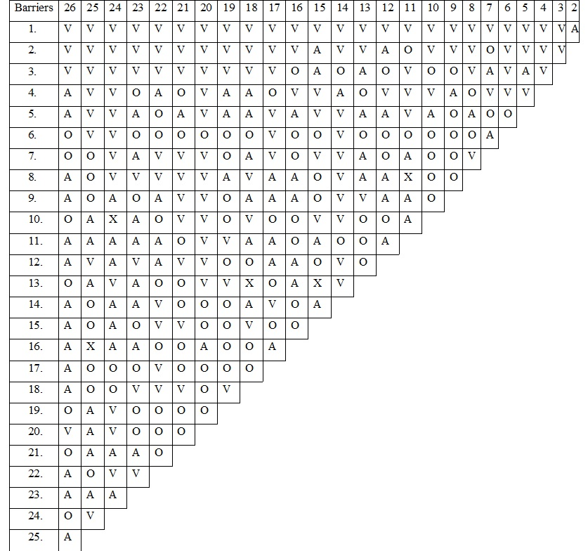
SSIM Matrix

Slide 13
Lack of knowledge barrier will influence to Fear of failure barrier, so the relationship of ‘V’ is denoted for barriers B1 and B4 in the SSIM.
The unwillingness of the top management barrier (B26) influenced by the financial constraints barrier (B17). Thus, the relationship between these barriers is denoted by ‘A’ in the SSIM.
No relationship exists between lack of internal communication barrier and the lack of new technology, materials and processes barrier and hence the relationship between these barriers is denoted by ‘O’ in the SSIM.

Slide 14
Initial Reachability Matrix
In this step, the reachability matrix is developed from SSIM. The SSIM format is initially converted into an initial reachability matrix format by transforming the information of each cell of SSIM into binary digits (i.e. ones or zeros) in the initial reachability matrix.
This transformation is done with the following rules:
If the entry in the cell (i, j) in the SSIM is V, then the cell (i, j) the entry becomes 1 and the cell (j, i) entry becomes 0 in the initial reachability matrix.
If the entry in the cell (i, j) in the SSIM is A, then the cell (i, j) entry becomes 0 and the cell (j, i) entry becomes 1 in the initial reachability matrix.
If the entry in the cell (i, j) in the SSIM is X, then the entries in both the cells (i, j) and (j, i) become 1 in the initial reachability matrix.
If the entry in the cell (i, j) in the SSIM is O, then the entries in both the cells (i, j) and (j, i) become 0 in the initial reachability matrix. Following these rules, the initial reachability matrix is as given in the Table

Slide 15
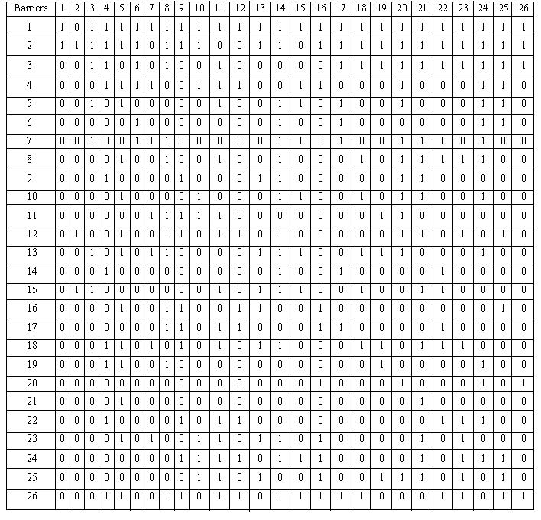
Initial Reachability Matrix

Slide 16
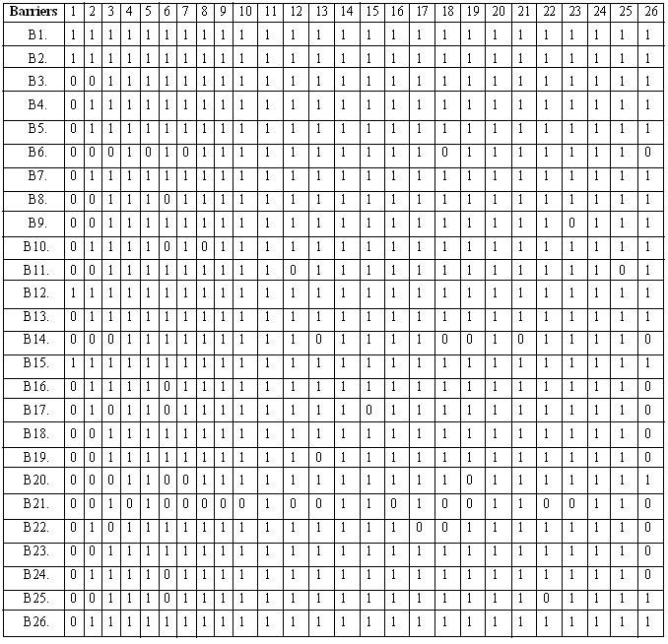
Final Reachability Matrix

Slide 17
Level Partitions
The reachability and antecedent set (Warfield, 1974) for each barrier is obtained from the final reachability matrix.
The reachability set for a particular variable consists of the variable itself and the other variables, which it may help achieve.
The antecedent set consists of the variable itself and the other variables, which may help in achieving them. Subsequently, the intersection of these sets is derived from all variables.
The variable for which the reachability and the intersection sets are the same is given the top-level variable in the ISM hierarchy, which would not help achieve any other variable above their own level.
After the identification of the top-level element, it is discarded from the other remaining variables. In this study, the 26 barriers, along with their reachability set, antecedent set, intersection set and levels, are presented in following Table. Level identification process of these barriers is completed in eight iterations.
From the table, it can be seen that fear of failure barrier is found in Level I. Thus, it would be positioned at the top of the ISM model. This iteration is continued till the levels of each variable are obtained. The identified levels aid in building the digraph and the final model of the ISM

Slide 18
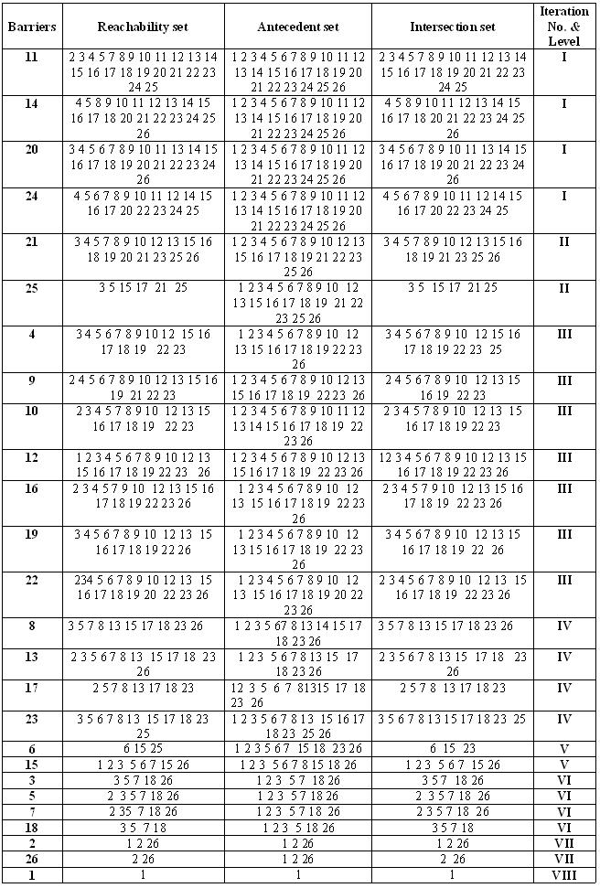
Level Partitions for Barriers: Iteration I- Iteration VII

Slide 19
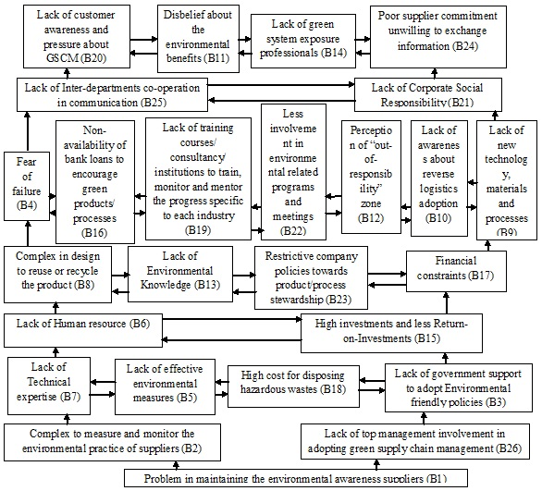
ISM based Model for Barriers

Slide 20
MICMAC Analysis
Matriced’Impacts croises-multipication applique´ and classment (cross-impact matrix multiplication applied to classification) is abbreviated as MICMAC. The MICMAC principle is based on multiplication properties of matrices (Sharma et al. 1995).
The purpose of MICMAC analysis is to analyze the drive power and dependence power of barriers.
This is done to identify the key barriers that drive the system in various categories. Based on their drive power and dependence power, the barriers, in the present case, have been classified into four categories

Slide 21
Autonomous barriers: These barriers have weak driving power and weak dependence. They are relatively disconnected from the system, with which they have few links, which may be very strong. These barriers are represented in Quadrant – I
Dependent barriers: This category includes those barriers which have weak drive power, but strong dependence power and placed in Quadrant – II
Linkage barriers: This category barriers has strong driving power as well as strong dependence and are placed in Quadrant - III.
Independent barriers: This category barriers has strong driving power but weak dependence power. These are represented in Quadrant – IV

Slide 22
Subsequently, the diagram of driving power vs. Dependence power for the barriers is constructed as shown in following Figure.
As an illustration, it is observed from Dependence and driving power Table that there are no barriers in Quadrant - I.
In Quadrant - II Lack of Corporate Social Responsibility (B21) having a driving power of 10 and a dependence power of 25.
Therefore, in the dependence and the driving power diagram, it is positioned in a place corresponding to a driving power of 10 and a dependence power of 25.
Similarly, remaining barriers are positioned corresponding to a driving and dependence power.

Slide 23
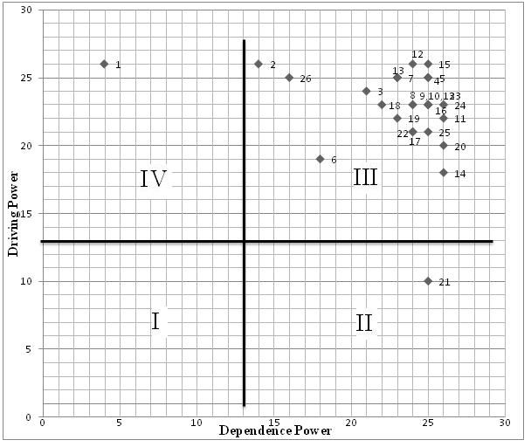
Driving Power and Dependence Power Diagram

Slide 24
Conclusions
The result of this study shows that Problem in maintaining the environmental awareness suppliers (B1) barrier is acting as a key barrier for the implementation of GSCM. Industries need to give special attention and first priority to remove this barrier.
Industries should be very keen on insisting for eco-friendly materials from the suppliers and also should promote the importance of being green by organizing environment related conferences or seminars.
Also, this study stresses that auto component industries have a need to move forward in the selection of suppliers by keeping in mind of green concepts.
If they select suppliers from green concept perspective, the final product from the their industry will be an environmental friendly product.
This will be helpful to improve their product image in the market and public as an eco-friendly product. Also, it will prove helpful to get government rewards and awards through different environmental schemes.

Slide 25
Thank you

